Slide 1
Mobius Band: Explore Hyper-V Attack Interface through Vulnerabilities Internals
Zhenhao Hong (@rthhh17)
Ant Group Light-Year Security Lab, Ex-researcher @IceSword Lab, Qihoo 360
Chuanjian Liao
IceSword Lab, Qihoo 360
#BHUSA @BlackHatEvents

Slide 2
whoami
Zhenhao Hong (@rthhh17)
@Ant Group Light-Year Security Lab
Ex-researcher @IceSword Lab, Qihoo 360
Awarded the 2019-2020 MSRC Most Valuable Security Researchers
Chuanjian Liao
Technical Director @IceSword Lab, Qihoo 360
Notes:
Hello everyone. Let me introduce myself first. My name is Zhenhao Hong, I have been working on virtualization security and Hyper-V security research for many years. I was awarded the 2019-2020 MSRC Most Valuable Security Researchers.
I also want to introduce my partner Chuanjian Liao, he is a Technical Director at 360 and leads the IceSwordLab whose primary focuses are operating system kernels, virtualization technology and computer security. In this topic, he made an indelible contribution.

Slide 3
Agenda
Hyper-V Architecture
Hyper-V Guest and Host Communication
Why Hyper-V is difficult
Vulnerabilities Details
Attack Interface
Concluding Thoughts
Notes:
This topic is divided into the following six parts.

Slide 4
Hyper-V Architecture
#BHUSA @BlackHatEvents

Slide 5
Architecture
Root Partition
Child Partition
VMWPs (Ring 3)
Ring 3
Ring 0
Ring 0
Host Drivers
Guest Drivers
VMBUS
VMBUS
Hypervisor (Ring -1)
Notes:
I simplified the Hyper-V architecture, as the picture shows. Next, I will introduce the important Hyper-V fundamental components.

Slide 6
Architecture - Hypervisor
Hypervisor
hvix64.exe
(Intel CPU)
hvax64.exe
(AMD CPU)
Memory Management
MSRs Virtualization
APIC Virtualization
VM-Exit Handlers
Nested Virtualization
etc...
Notes:
The first important component is the hypervisor component. Hypervisor component implements the following functions, they are Memory Management, MSRs Virtualization, APIC Virtualization, VM-Exit Handlers, Nested Virtualization.

Slide 7
Architecture - VMBUS
Host Kernel Space(Ring 0)
Guest Kernel Space(Ring 0)
VMBUS Host
vmbusr.sys
vmbkmclr.sys
winhvr.sys
VMBUS Guest
Linux : hv_vmbus.ko
Windows : vmbus.sys
vmbkmcl.sys
winhv.sys
NT (ntoskrnl.exe)
Guest Kernel
Hypervisor Ring -1 (hardware)
Notes:
The next important component is VMBUS component. VMBUS exists in Ring0 level of Host Machine and Guest Machine, it is used for data transmission between the Guest and the Host. VMBUS uses VMCALL instruction and interrupt injection technology to implement notification between Guest and Host.

Slide 8
Architecture – Host Drivers
Host Drivers
Network Virtualization
vmswitch.sys
vmsproxy.sys
vmsproxyhnic.sys
Storage Virtualization
storvsp.sys
vhdparser.sys
vhdmp.sys
VMBUS
PCI Virtualization
vpcivsp.sys
hvsocket
hvsocket.sys
hvsocketcontrol.sys
Notes:
There are some Host drivers that implement Hyper-V device virtualization in Guest Machine. For example, Network Virtualization component implements the function of Virtual Network Adapter in Guest. These Host drivers all use VMBUS to communicate with the Guest.

Slide 9
Architecture - VMWPs
vmconnect.exe (Virtual Machine Connection)
socket
VMWP.exe (Virtual Machine Worker Process)
Virtual Machine Integration Service
vmiccore.dll
vmicvdev.dll
Dynamic Memory Controller
vmdynmem.dll
VM UI Devices
vmuidevices.dll
etc…
I/O Write
I/O Read
VMBUS
Notes:
VMWP.exe process is the most important program of Hyper-V under Ring3. One Virtual Machine instance corresponds to one vmwp.exe process. Many Hyper-V components are included in vmwp.exe process. These components communicate with VMBUS through I/O read and write.

Slide 10
Hyper-V Guest and Host Communication
#BHUSA @BlackHatEvents

Slide 11
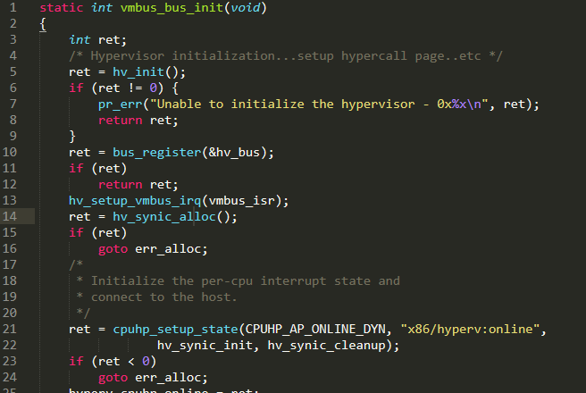
Communication
VMBUS initialize in Linux Guest.
Notes:
vmbus_bus_init function is used for initialize Linux Guest VMBUS.

Slide 12
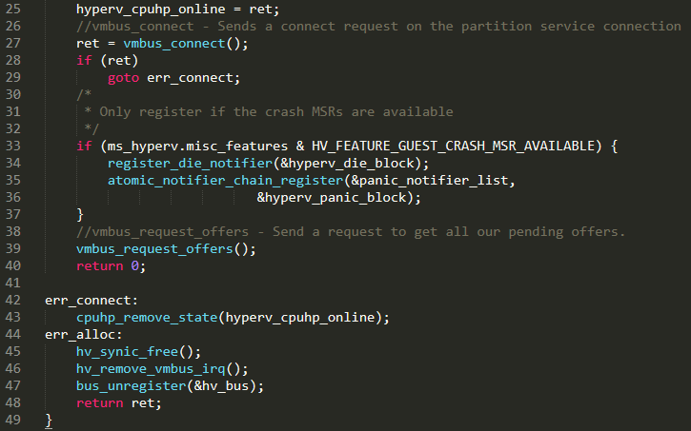
Communication
VMBUS initialize in Linux Guest.
Notes:
In this function, initializes hypervisor and register bus first, then invoke HV SYNIC ALLOC function and sends a connect request on the partition service connection. In the end, send a request to get all pending offers.

Slide 13
Communication
VMBUS device initialize.
vmbus_open
vmbus_open
CHANNELMSG_OPENCHANNEL
alloc_pages
hv_ringbuffer_init
vmbus_establish_gpadl
Allocate continuous pages for VMBUS ringbuffer.
VMBUS ringbuffer initialize.
Establish a GPADL for the specified buffer.
Use vmbus_post_msg send CHANNELMSG_GPADL_HEADER & CHANNELMSG_GPADL_BODY message to Host
Use vmbus_post_msg send CHANNELMSG_OPENCHANNEL message to Host
Notes:
vmbus_open function is used for Guest VMBUS device initialization. In the function, first allocate continuous pages for VMBUS ringbuffer and initialize VMBUS ringbuffer, second establish a GPADL for the specified buffer. Third, send CHANNELMSG_OPENCHANNEL message to Host.

Slide 14
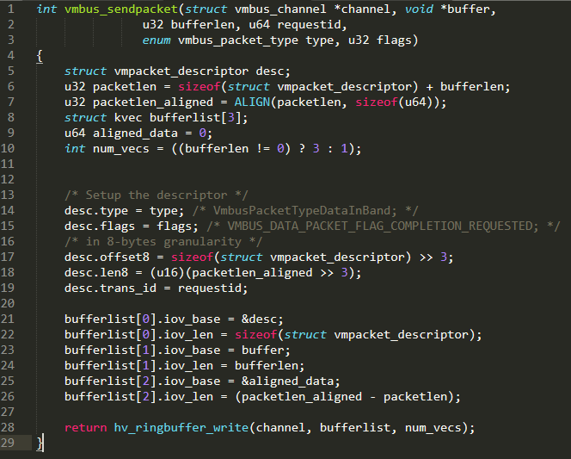
Communication
Send data to Host : vmbus_sendpacket
hv_ringbuffer_write
guestdata
hv_signal_on_write
vmbus_setevent
vmbus_set_event
hv_do_fast_hypercall8
Notes:
vmbus_sendpacket function is used for send guest data to Host. On the right, it is the calling chain of this function

Slide 15
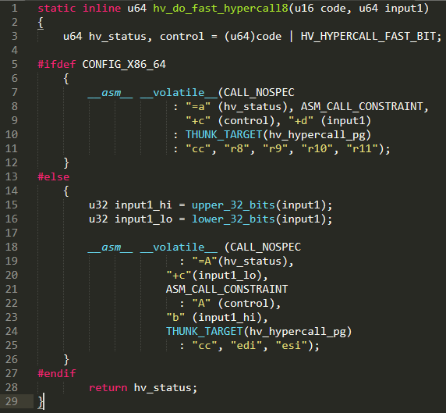
Communication
Send data to Host : vmbus_sendpacket
vmcall
hv_ringbuffer_write
guestdata
hv_signal_on_write
vmbus_setevent
vmbus_set_event
hv_do_fast_hypercall8
Notes:
hv_do_fast_hypercall8 will execute VMCALL instruction, and hypervisor will fall in a VM-Exit event.

Slide 16
Communication
Receive data form Host : vmbus_on_event
Notes:
vmbus_on_event function is used for receive data from Host.

Slide 17
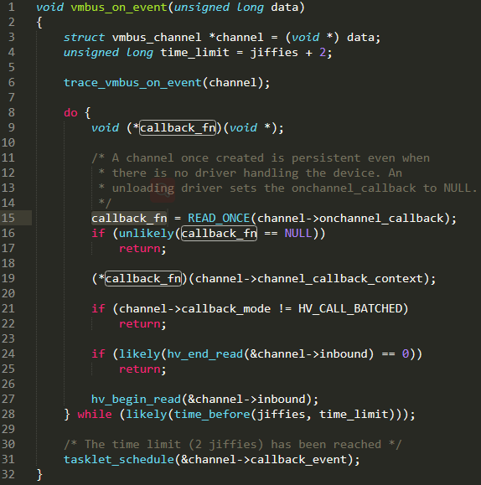
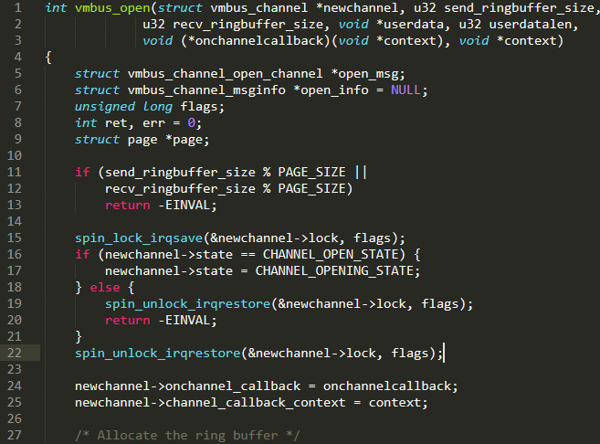
Communication
Receive data form Host : vmbus_on_event
Notes:
In this function, a callback function will be invoked. At the red mark, the callback function pointer will be set in vmbus_open function.

Slide 18
Communication
VMBUS in Host
There are two functions, vmbkmclr!KmclpVmbusManualIsr and vmbkmclr!KmclpVmbusIsr
vmbkmclr!KmclpVmbusIsr : distribute guest data to Host driver. (storvsp.sys vmswitch.sys …)
vmbkmclr!KmclpVmbusManualIsr : distribute guest data to host usermode component. (vmuidevices.dll vmdynmem.dll vmicvdev.dll …)
Notes:
There are two functions. The KMCLP VMBUS ISR is used for distribute guest data to Host driver, such as storvsp or vmswitch. KMCLP VMBUS Manual ISR is used for distribute guest data to host user-mode component, such as vmuidevices.

Slide 19
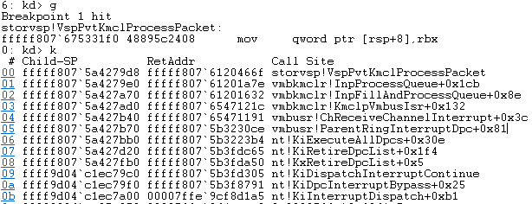
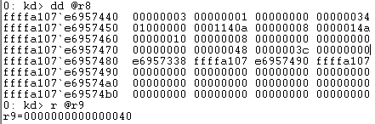
Communication
Data path to Ring0 (vmbkmclr!KmclpVmbusIsr)
For example, storvsp.sys
Guest data
Guest data Size
Notes:
The example of Ring zero data path is as follows, the Guest data pointer is the function’s third parameter, the Guest data size is the function’s fourth parameter.

Slide 20
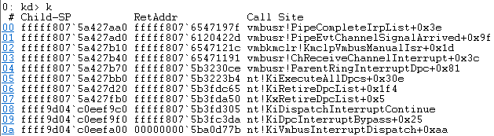
Communication
Data path to Ring3 (vmbkmclr!KmclpVmbusManualIsr)
For example, vmiccore.dll
Notes:
The example of Ring three data path is as follows, the function Pipe Complete IRP List will be invoked.

Slide 21
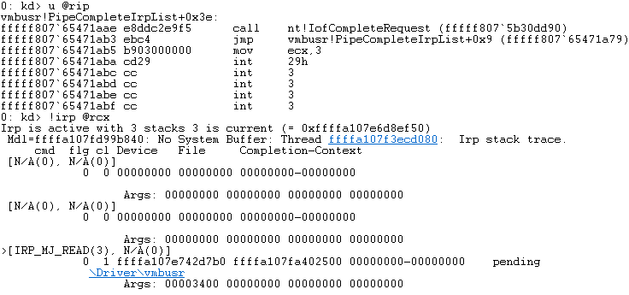
Communication
Data path to Ring3 (vmbkmclr!KmclpVmbusManualIsr)
For example, vmiccore.dll
Notes:
In this function, IofCompleteRequest will be invoked. In WINDBG, IRP command will display information about an I/O request packet.

Slide 22
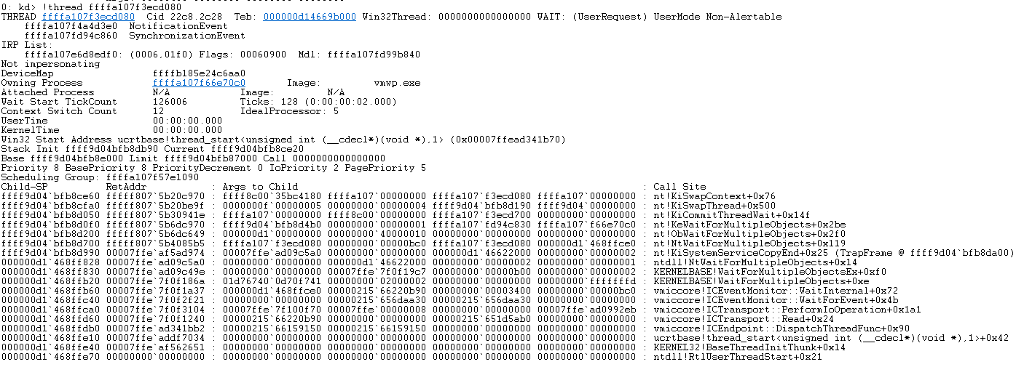
Communication
Data path to Ring3 (vmbkmclr!KmclpVmbusManualIsr)
For example, vmiccore.dll
Notes:
The thread’s stack Backtrace is as follows, the vmiccore component is waiting for data from the guest.

Slide 23
Why Hyper-V is difficult？
#BHUSA @BlackHatEvents

Slide 24
Compare with Win32k!EngRealizeBrush Integer Overflow (MS17-017)
win32k!EngRealizeBrush Integer Overflow Exploit
CreateBitmap allocate Bitmap object(size can be controlled)
RegisterClassEx allocate LpszMenuName object(Pool feng-shui for ENGBRUSH object)
CreatePalette allocate Palette object(size can be controlled & abuse object gaining memory R/W)
DeleteObject & UnRegisterClass control object free(Pool feng-shui)
We can control the content of Bitmap objects and Palette objects.(Construct memory R/W)
Notes:
I will take ENG realize brush as an example. Explain why Hyper-V is difficult. ENG realize brush integer overflow uses these functions to realize kernel pool feng-shui. We can construct memory read and write by controlling the content of bitmap objects and palette objects. It is easy to allocate palette objects in windows kernel by using createpalette API.

Slide 25
Compare with Win32k!EngRealizeBrush Integer Overflow (MS17-017)
 | Traditional EoP | Hyper-V Exploit
Attack Interface | Lots of APIs. Ring0 read data from User-Mode address directly. | No APIs. All data is transmitted via VMBUS, Ring0 unable to read data from Guest memory space directly.
Object Allocate & Free | Lots of objects can be abused so far. Allocate & Free kernel Object is easy control. Construct memory R/W by control the content of kernel objects. | No suitable object for abuse.(Still Finding…) Unable to control object Allocate & Free directly. Unable to control the timing of object Allocate & Free.(Because of VMBUS mechanism) There is very little content in the object that can be controlled from Guest.
TOC/TOU | Have a User-Mode pointer. Fetch the pointer(User-Mode memory) more than once. | All data is transmitted via VMBUS, Ring0 unable to read data from Guest memory space directly.
Notes:
This is the differences between the traditional Windows EOP exploit and the Hyper-V exploit. About Attack interface, traditional EOP has lots of APIs, Ring zero be able to read data from USER-mode address directly. But Hyper-V has no APIs and all data transmitted via VMBUS, ring zero unable to read data from Guest memory space directly.
About Object allocate and free, traditional EOP exploit has lots of objects can be abused so far, allocate and free kernel object is easy control, construct memory read and write by controlling the content of kernel objects. Hyper-V exploit has no suitable object for abuse, but I’m still looking for. And unable to control object allocate and free directly, even can not control the timing of object allocate and free, because of VMBUS mechanism. There are very little content in the object that can be controlled from Guest.
About TOC/TOU vulnerability, there are two key factors in a TOCTTOU vulnerability. One is that the parameter passed from a user-mode program should be a pointer. The other is that the system call handler fetches the parameter from user memory more than once. But Hyper-V all data is transmitted via VMBUS, Ring0 unable to read data from Guest memory space directly.
This is why Hyper-V is difficult.

Slide 26
Vulnerabilities details
#BHUSA @BlackHatEvents
Notes:
Let’s talking about vulnerabilities details.

Slide 27
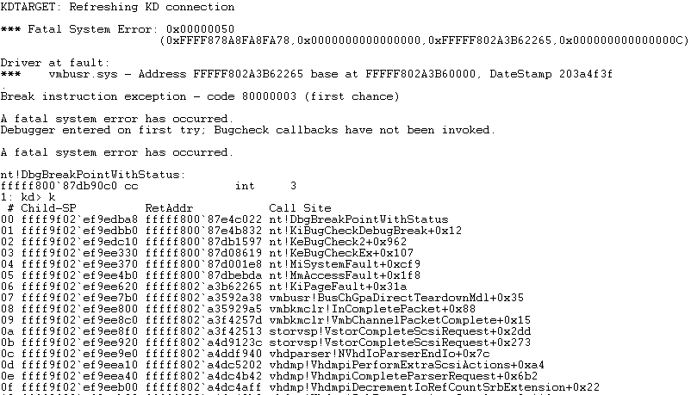
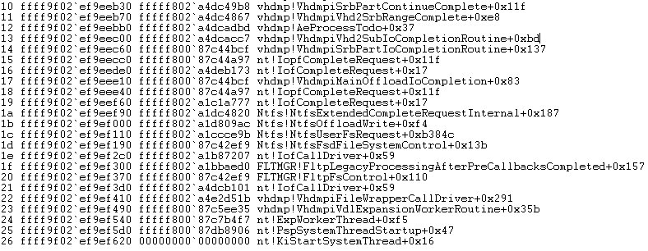
CVE-2019-0620
Notes:
The first RCE vulnerability introduced is cve-2019-0620. This vulnerability exists in VHDMP and STORVSP sys file. This picture is the stack backtrace when this vulnerability is triggered.

Slide 28
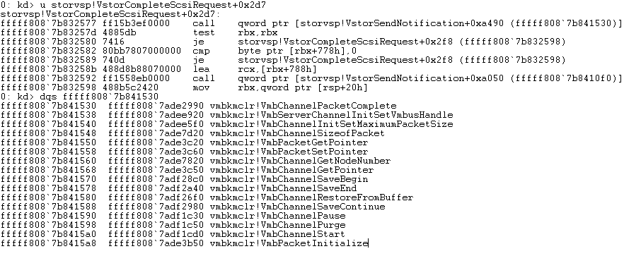
CVE-2019-0620
Root cause : Into vmbkmclr!VmbChannelPacketComplete twice with SAME first parameter.
Notes:
The root cause of this vulnerability is into VMB channel packet complete function twice with the same first parameter. As shown in the picture, the VMB channel packet complete function will be invoked at Vstor Complete SCSI Request offset 0x2d7.

Slide 29
CVE-2019-0620
bp storvsp!VstorCompleteScsiRequest+0x2d7 "r @rcx;k;r @$thread;!pool @rcx;.echo ; g“
Trigger this issue, and see what happened in WinDbg.
Notes:
Let’s set a breakpoint here, trigger this issue and see what happened.

Slide 30
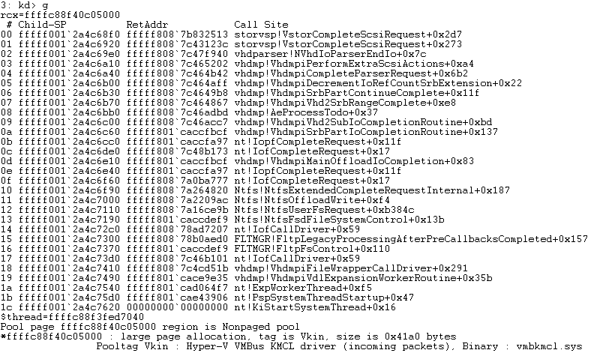
CVE-2019-0620
bp storvsp!VstorCompleteScsiRequest+0x2d7 "r @rcx;k;r @$thread;!pool @rcx;.echo ; g“
Trigger this issue, and see what happened in WinDbg.
Notes:
In WINDBG, a thread triggers this breakpoint and calling VMB channel packet complete function with blablabla four zero C zero five zero zero zero as the first parameter.

Slide 31
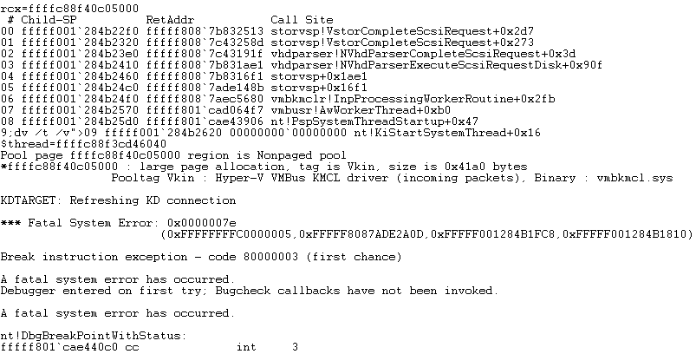
CVE-2019-0620
bp storvsp!VstorCompleteScsiRequest+0x2d7 "r @rcx;k;r @$thread;!pool @rcx;.echo ; g“
Trigger this issue, and see what happened in WinDbg.
Notes:
And then, another thread triggers this breakpoint too, and calling VMB channel packet complete function with the same first parameter! BOOM! Bluescreen.

Slide 32
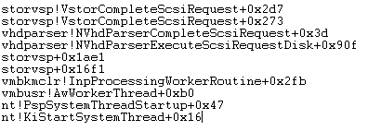
CVE-2019-0620
The following Stack Backtrace can be trigger in normal procedure.
Notes:
Let's analyze this vulnerability. The following Stack Backtrace can be trigger in normal procedure. So, leave it alone, Let's look at the next one.

Slide 33
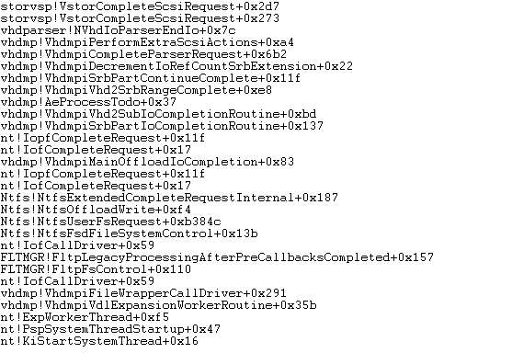
CVE-2019-0620
The following Stack Backtrace can be trigger only vhdmp! VhdmpiPerformExtraScsiActions second parameter offset 0x08’s memory is not NULL.
Notes:
The following Stack Backtrace can be trigger only Vhdmpi Perform Extra Scsi Actions second parameter offset 0x08’s memory is not NULL.

Slide 34
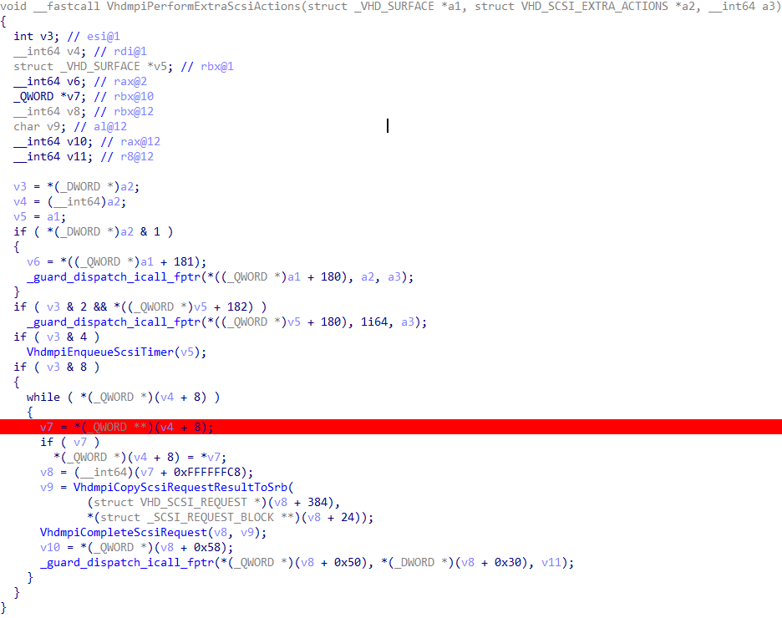
CVE-2019-0620
The following Stack Backtrace can be trigger only vhdmp! VhdmpiPerformExtraScsiActions second parameter offset 0x08’s memory is not NULL.
Notes:
As you can see, if v4 offset eight’s memory is not zero, above stack Backtrace will be triggered.

Slide 35
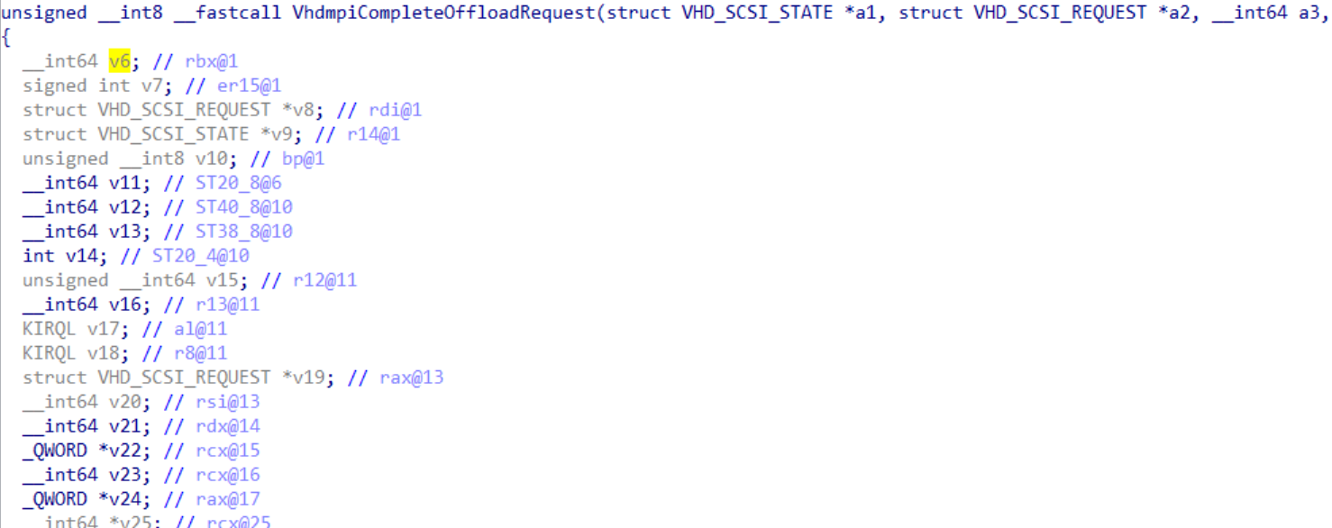
CVE-2019-0620
vhdmp!VhdmpiPerformExtraScsiActions second parameter offset 0x08’s memory is set by vhdmp!VhdmpiCompleteOffloadRequest
2
Notes:
By referring to reverse engineering, I found Vhdmpi Perform Extra Scsi Actions second parameter offset 0x08’s memory is set by Vhdmpi Complete Offload Request.

Slide 36
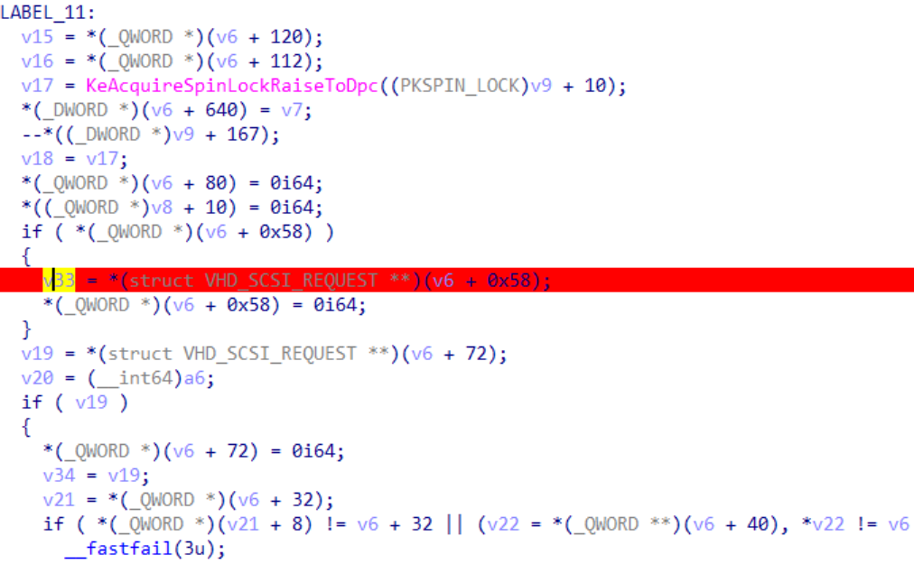
CVE-2019-0620
vhdmp!VhdmpiPerformExtraScsiActions second parameter offset 0x08’s memory is set by vhdmp!VhdmpiCompleteOffloadRequest
2
Notes:
In the function Vhdmpi Complete Offload Request, the value of v6 offset 0x58 is passed to v33.

Slide 37
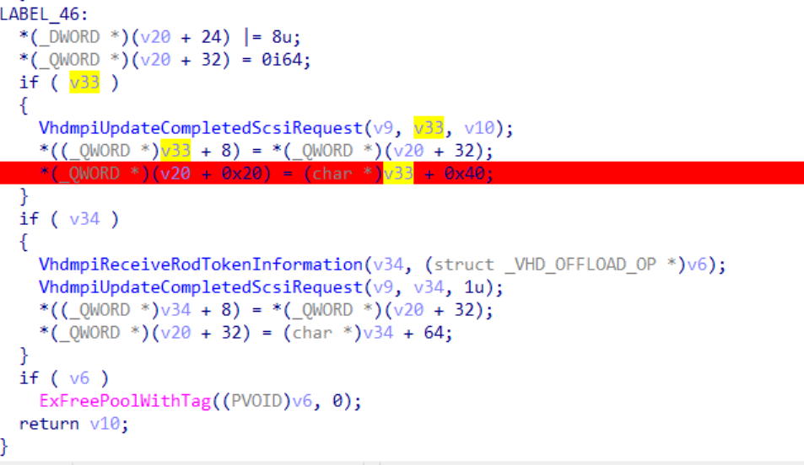
CVE-2019-0620
vhdmp!VhdmpiPerformExtraScsiActions second parameter offset 0x08’s memory is set by vhdmp!VhdmpiCompleteOffloadRequest
2
vhdmp!VhdmpiPerformExtraScsiActions second parameter
offset 0x08’s memory is *(_QWORD *)(v20 + 0x20)
Notes:
And then, put v33 add 0x40 in v20 offset 0x20’s memory. Actually, the value of v20 offset 0x20 is the value of Vhdmpi Perform Extra Scsi Actions second parameter offset 0x08.

Slide 38
CVE-2019-0620
In vhdmp!VhdmpiCompleteOffloadRequest, where is *(struct VHD_SCSI_REQUEST **)(v6 + 0x58) be set?
Notes:
In Vhdmpi Complete Offload Request function, where is the value of v6 offset 0x58 be set?

Slide 39
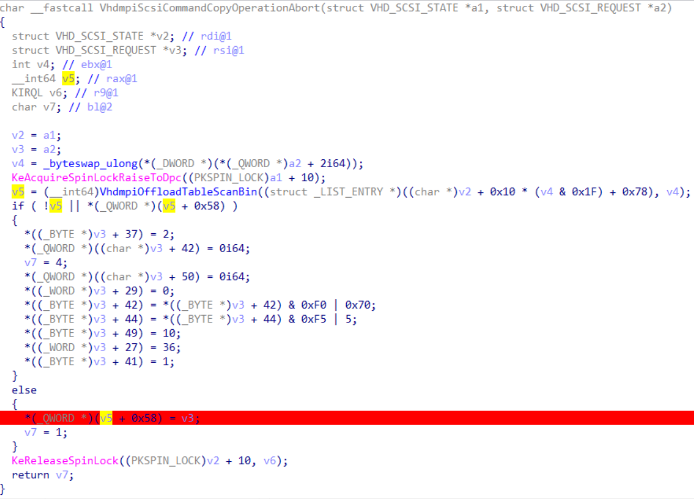
CVE-2019-0620
In vhdmp!VhdmpiCompleteOffloadRequest, where is *(struct VHD_SCSI_REQUEST **)(v6 + 0x58) be set.
Guest Data
Notes:
By referring to reverse engineering, I found VHDMPI SCSI Command Copy Operation Abort function set the value of v6 offset 0x58. At the red mark in the picture. In this function, VHDMPI Offload Table Scan Bin searches a specified VHD OFFLOAD OP object through its second parameter. The second parameter can be controlled by Guest.

Slide 40
CVE-2019-0620
vhdmp!VhdmpiOffloadTableInsertLocked will insert an _VHD_OFFLOAD_OP object into OffloadTable.
vhdmp!VhdmpiScsiCommandWriteUsingToken will invoke vhdmp!VhdmpiOffloadTableInsertLocked.
Notes:
I found VHDMPI Offload Table Insert Locked function will insert a VHD OFFLOAD OP object into Offload Table. We can invoke this function by calling VHDMPI SCSI Command Write Using Token function.

Slide 41
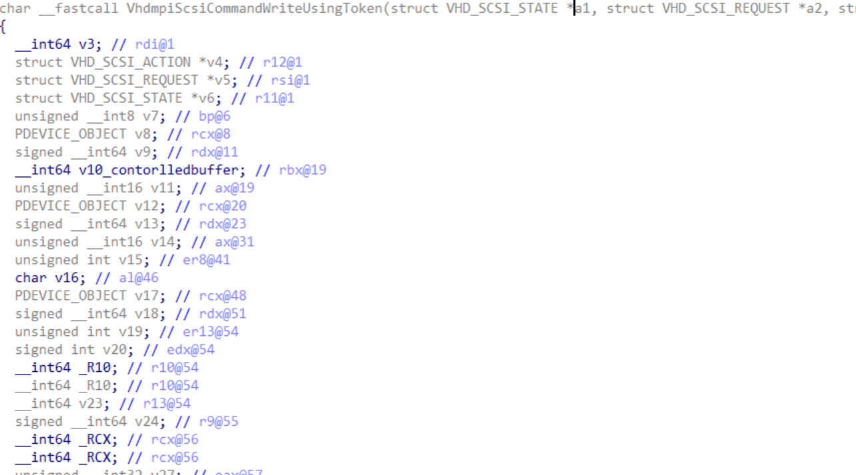
CVE-2019-0620
vhdmp!VhdmpiOffloadTableInsertLocked will insert an _VHD_OFFLOAD_OP object into OffloadTable.
vhdmp!VhdmpiScsiCommandWriteUsingToken will invoke vhdmp!VhdmpiOffloadTableInsertLocked.
Notes:
VHDMPI SCSI Command Write Using Token function can be triggered from Guest, and some data in this function can be controlled from Guest.

Slide 42
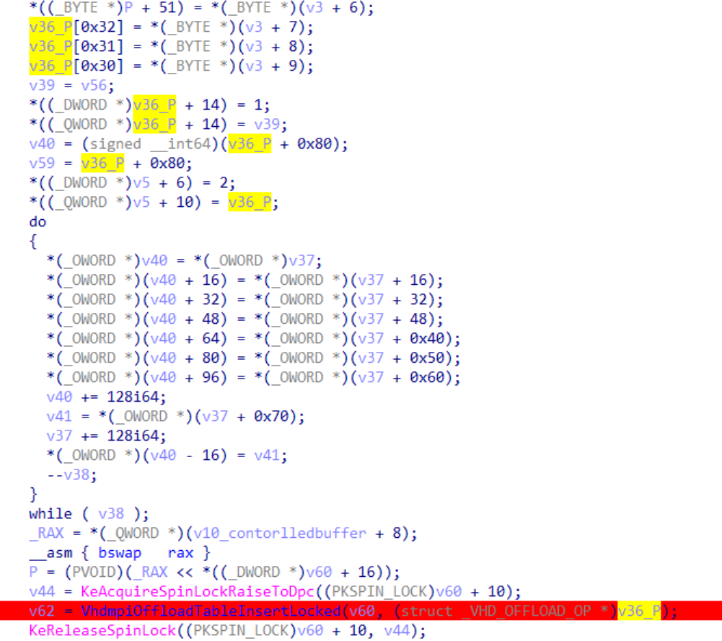
CVE-2019-0620
vhdmp!VhdmpiOffloadTableInsertLocked will insert an _VHD_OFFLOAD_OP object into OffloadTable.
vhdmp!VhdmpiScsiCommandWriteUsingToken will invoke vhdmp!VhdmpiOffloadTableInsertLocked.
Notes:
Let’s what VHDMPI Offload Table Insert Locked looks like.

Slide 43
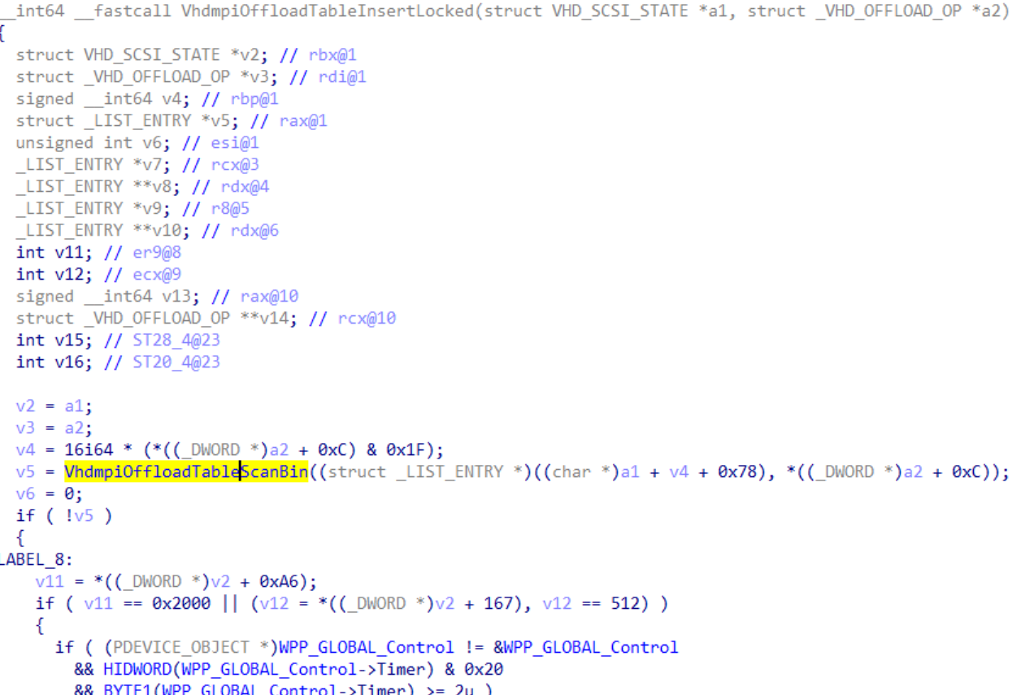
CVE-2019-0620
vhdmp!VhdmpiOffloadTableInsertLocked will insert an _VHD_OFFLOAD_OP object into OffloadTable.
vhdmp!VhdmpiScsiCommandWriteUsingToken will invoke vhdmp!VhdmpiOffloadTableInsertLocked.
Notes:
In the picture, this function also invokes VHDMPI Offload Table Scan Bin function.

Slide 44
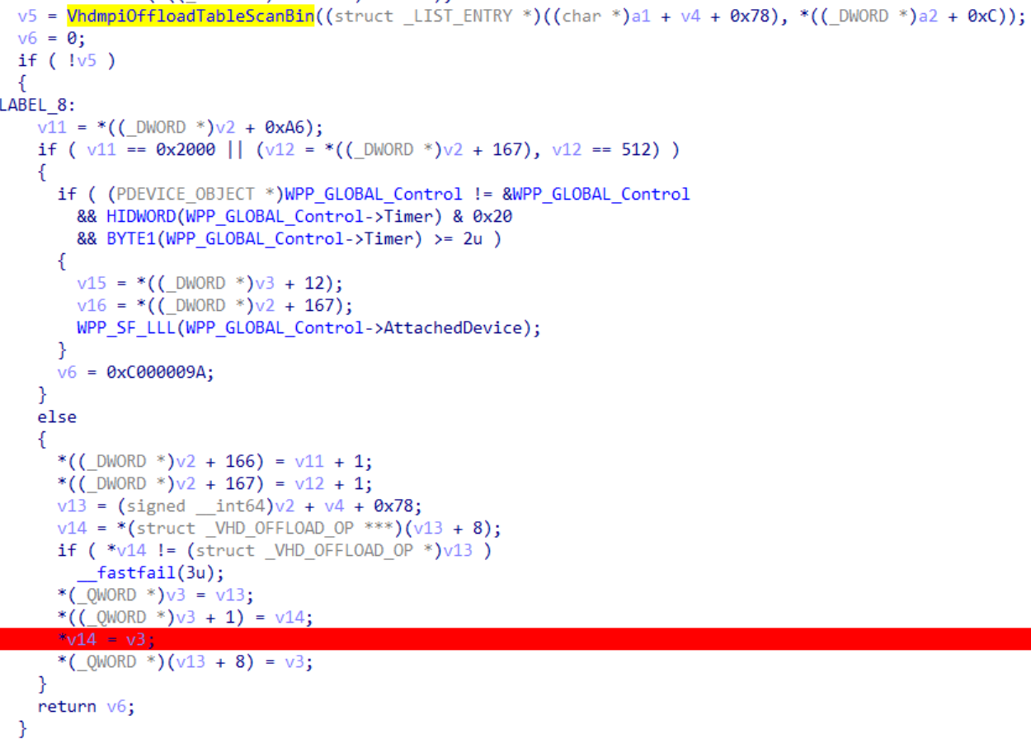
CVE-2019-0620
Guest Data
vhdmp!VhdmpiOffloadTableInsertLocked will insert an _VHD_OFFLOAD_OP object into OffloadTable.
vhdmp!VhdmpiScsiCommandWriteUsingToken will invoke vhdmp!VhdmpiOffloadTableInsertLocked.
Insert into OffloadTable
Notes:
The second parameter of VHDMPI Offload Table Scan Bin also can be controlled from Guest. In the following code, a specified VHD OFFLOAD OP object will be inserted into the Offload Table.

Slide 45
CVE-2019-0620
Use vhdmp!VhdmpiScsiCommandWriteUsingToken & vhdmp! VhdmpiScsiCommandCopyOperationAbort pair can trigger the following Stack Backtrace.
Notes:
Now, we can use Command Write Using Token and Command Copy Operation Abort to trigger the following stack Backtrace.

Slide 46
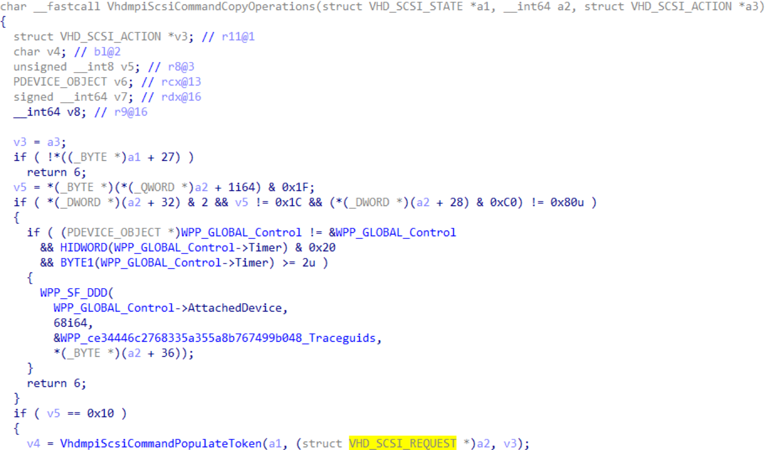
CVE-2019-0620
vhdmp!VhdmpiScsiCommandCopyOperations
v5 is outcode in PoC Code
Notes:
But, Let’s look at VHDMPI SCSI Command Copy Operations function first. In this function, the value of v5 can be controlled from Guest, in PoC I call it outcode.

Slide 47
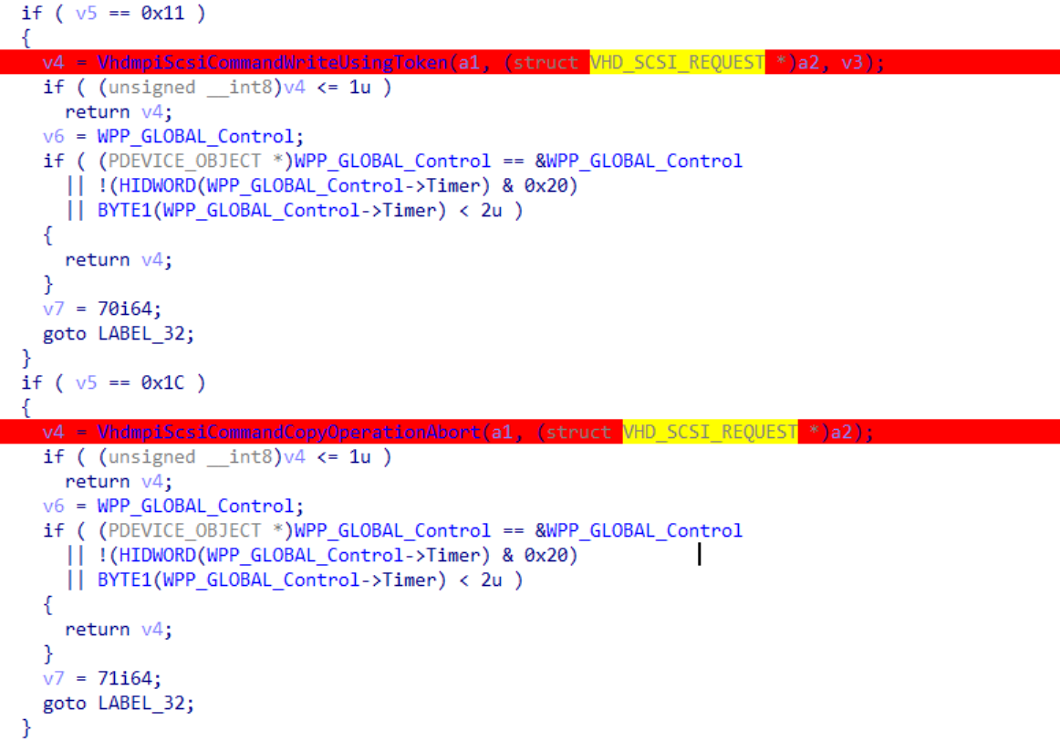
CVE-2019-0620
v5 can be controlled by Guest
vhdmp!VhdmpiScsiCommandCopyOperations
v5 is outcode in PoC Code
Notes:
If the value of v5 is 0x11, will invoke Command Write Using Token function. If the value of v5 is 0x1C, will invoke Command Copy Operation Abort function.

Slide 48
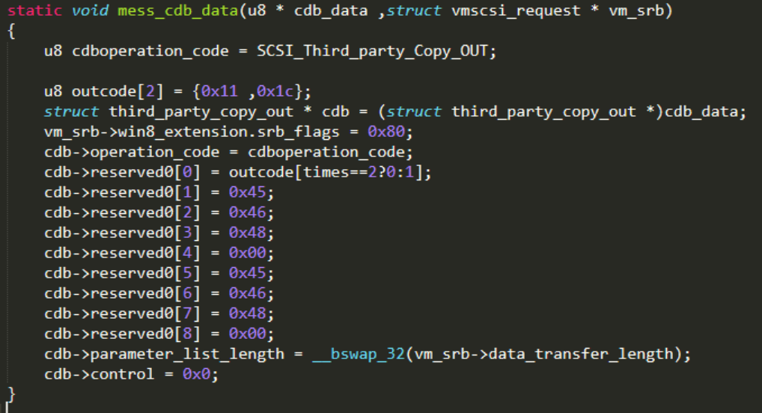
CVE-2019-0620
PoC Code
Notes:
This is PoC.

Slide 49
CVE-2019-0620
PoC Code
0x11 : vhdmp!VhdmpiScsiCommandWriteUsingToken
0x1C : vhdmp!VhdmpiScsiCommandCopyOperationAbort
Used for vhdmp!VhdmpiScsiCommandCopyOperationAbort
Used for vhdmp!VhdmpiScsiCommandWriteUsingToken
Notes:
CDB reserved0 one to four is used for Command Copy Operation Abort. five to eight is used for Command Write Using Token.

Slide 50
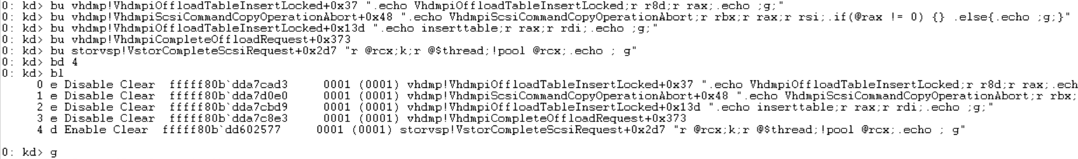
CVE-2019-0620 debugging & trigger
Notes:
Now, let’s trigger this vulnerability and debugging.

Slide 51
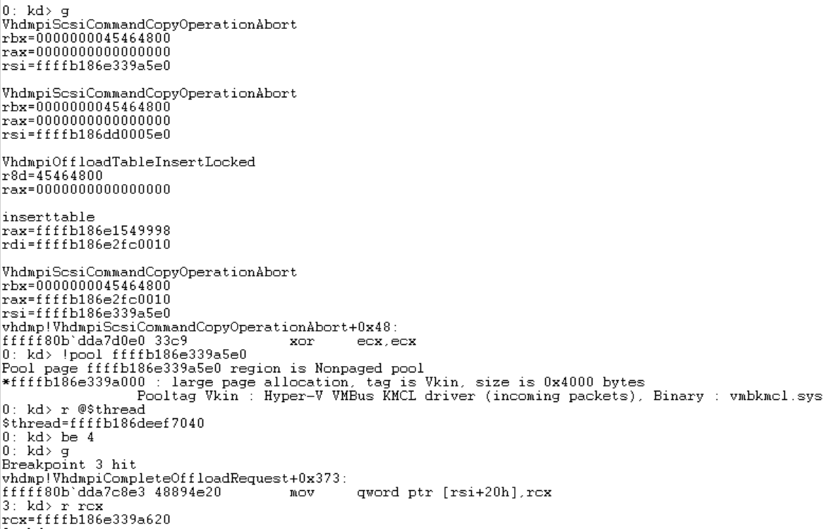
CVE-2019-0620 debugging & trigger
Notes:
First, Offload Table Insert Locked second parameter is 0x45464800 and the return value is zero, then insert a VHD OFFLOAD OP object into Offload Table. And then Command Copy Operation Abort searches a specified object in Offload Table and return an object pointer. Next, put a pointer into this object offset 0x58’s memory. Continue program and a complete offload request breakpoint will trigger. You can see the RCX register value is the above pointer.

Slide 52
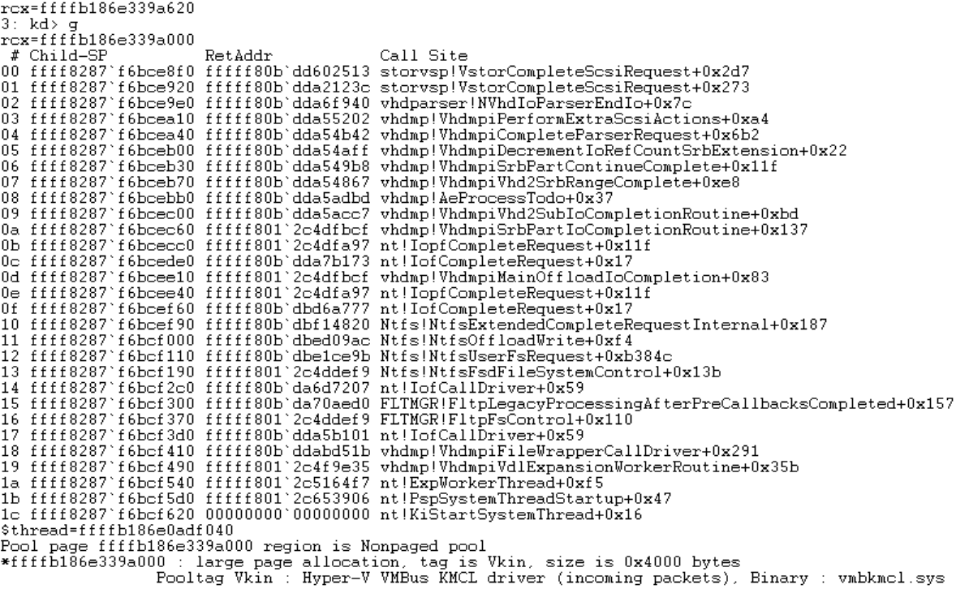
CVE-2019-0620 debugging & trigger
Notes:
Continue, in the picture, VMB channel packet complete function’s first parameter is the above pointer.

Slide 53
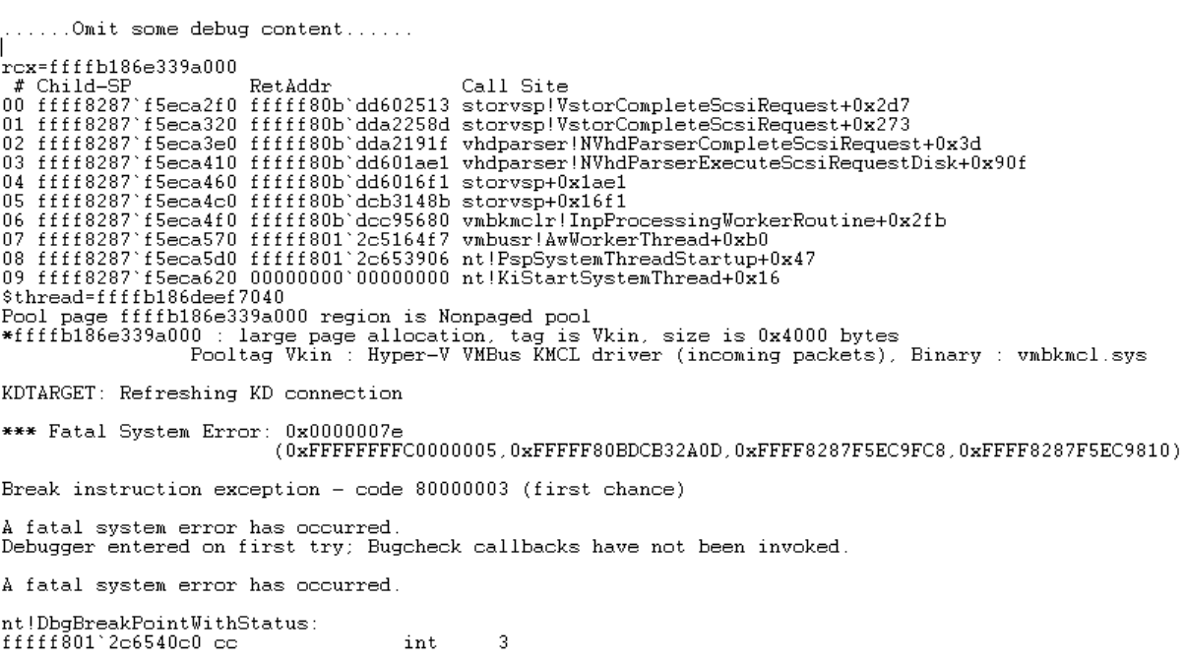
CVE-2019-0620 debugging & trigger
Notes:
And then, another thread calling VMB channel packet complete function with the same first parameter.

Slide 54
CVE-2019-0620
Exploit thinking
PoC has a chance to cause UAF.
Find suitable object for kernel pool Spray.
Why failed?
No object of suitable size was found…
Notes:
About exploit thinking, the PoC has a chance to cause UAF. So, I should find a suitable object for kernel pool spray. But no object of suitable size was found.

Slide 55
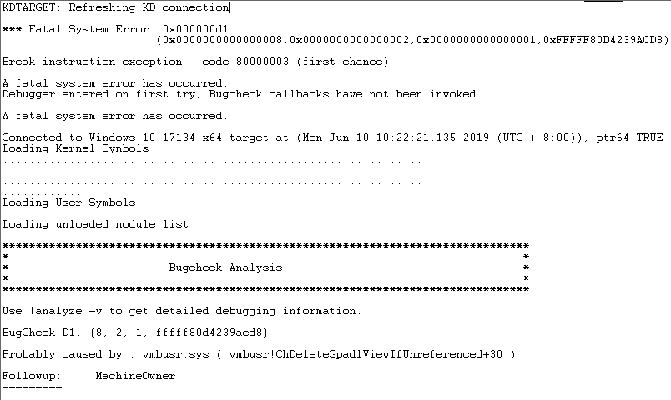
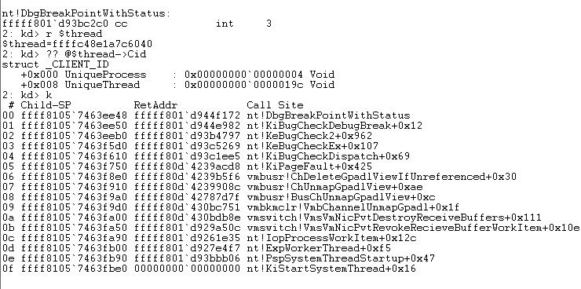
CVE-2019-0720
Notes:
Now I will introduce CVE-2019-0720, as shown in the picture, it is the Stack Backtrace when this vulnerability is triggered. As you can see, system crashes at vmbusr!ChDeleteGpadlViewIfUnreferenced, let's see what it looks like in the function vmbusr!ChUnmapGpadlView.

Slide 56
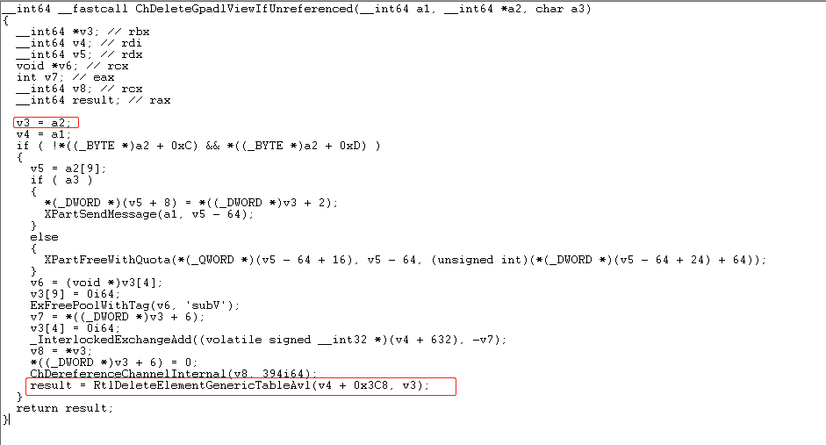
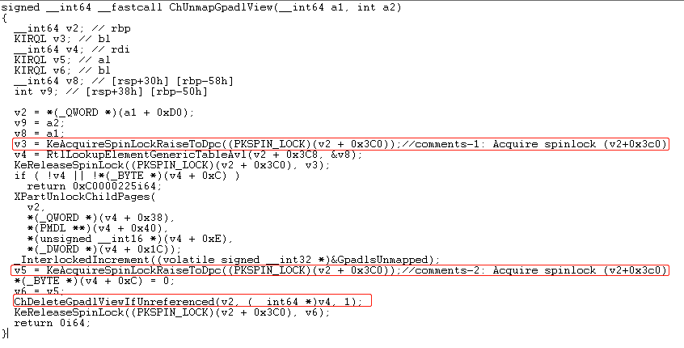
CVE-2019-0720
RtlDeleteElementGenericTableAvl’s second parameter is the return value from RtlLookupElementGenericTableAvl
Delete from generic table and free
Notes:
In Ch Unmap Gpad lView function, RtlLookupElementGenericTableAvl searches a generic table for an element that matches the specified data, the specified data’s address is v8’s address, the specified data’s content is a1 and a2, v4 is the matching element pointer. Then pass v4 as the second parameter of function vmbusr!ChDeleteGpadlViewIfUnreferenced. In function vmbusr!ChDeleteGpadlViewIfUnreferenced, delete v4 from a generic table and free.

Slide 57
CVE-2019-0720
RtlDeleteElementGenericTableAvl not only deletes a specified element from a generic table, but also free the specified element.
vmbusr!ChUnmapGpadlView’s second parameter is “gpadl_handle”, “gpadl_handle” can be controlled by Guest Machine.
Notes:
By reverse engineering, I found RtlDeleteElementGenericTableAvl not only deletes a specified element from a generic table, but also free the specified element. And I found vmbusr!ChUnmapGpadlView’s second parameter is gpadl_handle, gpadl_handle can be controlled by Guest Machine.

Slide 58
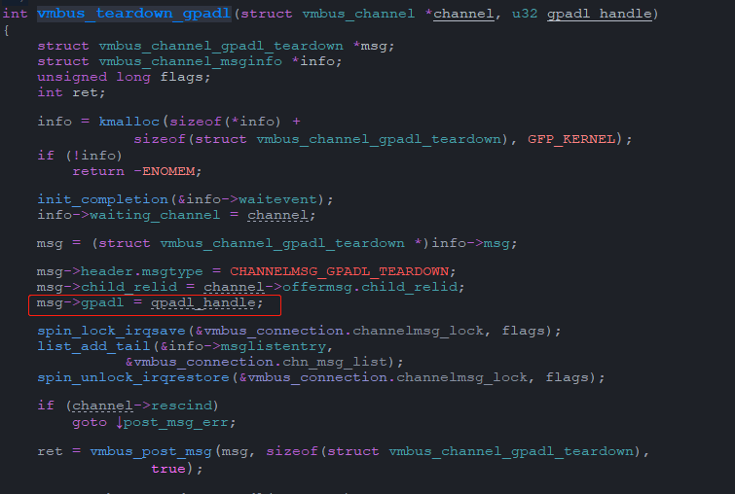
CVE-2019-0720
RtlDeleteElementGenericTableAvl not only deletes a specified element from a generic table, but also free the specified element.
vmbusr!ChUnmapGpadlView’s second parameter is “gpadl_handle”, “gpadl_handle” can be controlled by Guest Machine.
Reference: Linux Kernel Source Tree
Notes:
I found by calling function vmbus_teardown_gpadl in guest machine, we can reach to function vmbusr!ChUnmapGpadlView in Host. And the gpadl_handle can be controlled by Guest Machine.

Slide 59
CVE-2019-0720
Important information about vmbusr!ChUnmapGpadlView
vmbusr!ChUnmapGpadlView will running at a multithreaded environment; Actually Multi-core processor environment.
vmbusr!ChUnmapGpadlView second parameter controlled by Guest data(gpadl_handle), and the first parameter can be controlled by what channel we use indirectly;
Notes:
There are some important information about vmbusr!ChUnmapGpadlView. This function will running at a multithreaded environment; Actually Multi-core processor environment. This function second parameter controlled by Guest data gpadl_handle, and the first parameter can be controlled by what channel we use indirectly.

Slide 60
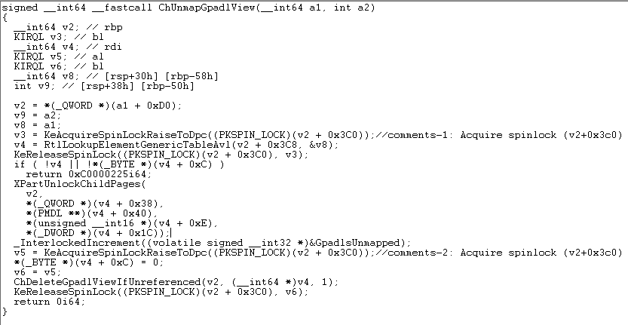
CVE-2019-0720
Start
End
State-1
State-2
State-1
State-2
State-3
State-3
Notes:
As shown in the picture, I divided the function vmbusr!ChUnmapGpadlView into three parts with different colors. State one already acquired the spin lock and invoke RtlLookupElementGenericTableAvl, and then exit the critical region. State two do something and try to acquire spin lock. State three will invoke ChDeleteGpadlViewIfUnreferenced and exit the critical region.

Slide 61
CVE-2019-0720
Assume the following situation:
There are two threads: ThreadA & ThreadB; Running on different CPUs.
ThreadA & ThreadB will running to vmbusr!ChUnmapGpadlView at the same time.
Both of two threads call function vmbusr!ChUnmapGpadlView have SAME parameter.
ThreadA a little more faster than ThreadB.
Notes:
Now, we assume the following situation: There are two threads: ThreadA and ThreadB; They are running on different CPUs. ThreadA and ThreadB will running to vmbusr!ChUnmapGpadlView at the same time. Both of two threads call function vmbusr!ChUnmapGpadlView have SAME parameter. And ThreadA a little more faster than ThreadB. According to the above assume, the following is the two threads' steps.

Slide 62
ThreadA
ThreadB
CVE-2019-0720
Start
End
Start
End
Steps – 1
ThreadA will first acquire the spinlock(spinlock address : v2+0x3c0) and into a critical region. (State-1)
At the same time, ThreadB will waiting for the spinlock.
wait
State-1
State-1
State-2
State-2
State-3
State-3
Notes:
Step one, ThreadA will first acquire the spin lock. ThreadA is in state one, and holds the lock. At the same time, ThreadB will waiting for the spin lock.

Slide 63
ThreadA
ThreadB
CVE-2019-0720
Start
End
Start
End
Steps – 2
ThreadA call function RtlLookupElementGenericTableAvl and return a pointer PointerA. (State-1)
Release the spinlock and exit the critical region.
wait
State-1
State-1
PointerA
State-2
State-2
State-3
State-3
Notes:
Step two, ThreadA call function RtlLookupElementGenericTableAvl and return a pointer PointerA. Then ThreadA release the spin lock.

Slide 64
ThreadA
ThreadB
CVE-2019-0720
Start
End
Start
End
Steps – 3
ThreadB acquire the same spinlock(spinlock address : v2+0x3c0) and into a critical region. (State-1)
ThreadA acquire spinlock and waiting for the spinlock. (State-2)
State-1
State-1
State-2
State-2
wait
State-3
State-3
Notes:
Step three, ThreadB acquire the same spin lock. ThreadA acquire spinlock and waiting for the spin lock. Now, ThreadA is in state two, ThreadB is in state one and holds the lock.

Slide 65
ThreadA
ThreadB
CVE-2019-0720
Start
End
Start
End
Steps – 4
ThreadB call function RtlLookupElementGenericTableAvl and return a pointer PointerB. (State-1)
Release the spinlock and exit the critical region.
Two threads call function vmbusr!ChUnmapGpadlView have SAME parameter, PointerB == PointerA.
State-1
State-1
PointerB
State-2
State-2
wait
State-3
State-3
Notes:
Step four, ThreadB call function RtlLookupElementGenericTableAvl and return a pointer PointerB. Then release the spin lock. Because two threads call function vmbusr!ChUnmapGpadlView have SAME parameter, PointerB is equal to PointerA.

Slide 66
ThreadA
ThreadB
CVE-2019-0720
Start
End
Start
End
Steps – 5
ThreadA will acquire the spinlock(spinlock address : v2+0x3c0) at the second KeAcquireSpinLockRaiseToDpc and into a critical region. (State-3)
Call function vmbusr!ChDeleteGpadlViewIfUnreferenced to free memory which PointerA points to, and delete the element(PointerA) from a generic table.
Release the spinlock and exit the critical region.
State-1
State-1
State-2
State-2
wait
State-3
State-3
Free PointerA
Notes:
Step five, ThreadA will acquire the spin lock. Then invoke function vmbusr!ChDeleteGpadlViewIfUnreferenced to free memory which PointerA points to, and delete PointerA from a generic table. Now, ThreadB is in state two, ThreadA is in state three.

Slide 67
ThreadA
ThreadB
CVE-2019-0720
Start
End
Start
End
Steps – 6
ThreadB will acquire the spinlock(spinlock address : v2+0x3c0) at the second KeAcquireSpinLockRaiseToDpc and into a critical region. (State-3)
Call function vmbusr!ChDeleteGpadlViewIfUnreferenced to free memory which PointerB points to, and delete the element(PointerB) from a generic table.
State-1
State-1
State-2
State-2
State-3
State-3
Free PointerB
Notes:
Step six, ThreadB will acquire the spin lock. And then invoke function vmbusr!ChDeleteGpadlViewIfUnreferenced free memory which PointerB points to.

Slide 68
ThreadA
ThreadB
CVE-2019-0720
Start
End
Start
End
Steps – 6
PointerA == PointerB
vmbusr!ChDeleteGpadlViewIfUnreferenced will use an already freed memory's pointer as the second parameter.
UAF!!!
State-1
State-1
State-2
State-2
State-3
State-3
Use freed PointerA
Notes:
Because PointerA is equal to PointerB, vmbusr!ChDeleteGpadlViewIfUnreferenced will use an already freed memory's pointer as the second parameter. Then, cause UAF!

Slide 69
CVE-2019-0720
Two necessary conditions
Two non-interfering threads run to function vmbusr!ChUnmapGpadlView.
Two threads call function vmbusr!ChUnmapGpadlView have SAME parameters.
Notes:
So, if we want to trigger this issue, we must have two necessary conditions: One. There are two non-interfering threads run to function vmbusr!ChUnmapGpadlView; Two. Two threads call this function have same second parameter, in a word, have same gpadl_handle.

Slide 70
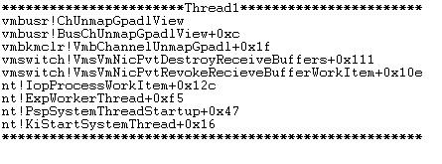
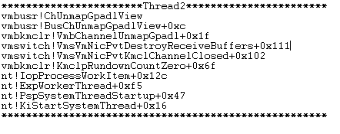
CVE-2019-0720
Fortunately☺ the following are two threads’ stack backtrace satisfy the necessary conditions.
Notes:
Fortunately, I found two threads call function vmbusr!ChUnmapGpadlView have same second parameter, and in a guest machine environment I can control these two threads be able to become two non-interfering threads. The picture is these two threads' Stack Backtrace.

Slide 71
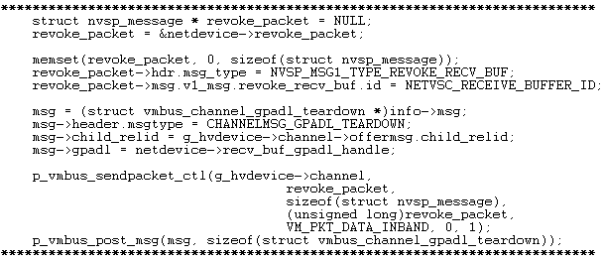
CVE-2019-0720
Thread1 can be triggered by send NVSP_MSG1_TYPE_REVOKE_RECV_BUF nvsp_message message and CHANNELMSG_GPADL_TEARDOWN message in a guest machine.
Notes:
Thread1 can be triggered by send NVSP_MSG1_TYPE_REVOKE_RECV_BUF nvsp_message message and CHANNELMSG_GPADL_TEARDOWN message in a guest machine. The picture is the implementation in PoC.

Slide 72
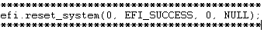
CVE-2019-0720
Thread2 can be triggered by simulation press system reset key in a guest machine.
AND! "efi.reset_system(0, EFI_SUCCESS, 0, NULL);" can trigger an important thread to control above Thread1&Thread2 become two non-interfering threads. The following is the important thread's stack backtrace.
Notes:
Thread2 can be triggered by simulation press system reset key in a guest machine. The picture is the implementation in PoC. Meanwhile, EFI reset_system can trigger an important thread to control above Thread1 and Thread2 become two non-interfering threads.

Slide 73
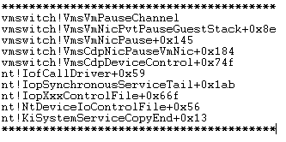
CVE-2019-0720
Thread2 can be trigger by simulation press system reset key in a guest machine.
AND! "efi.reset_system(0, EFI_SUCCESS, 0, NULL);" can trigger a important thread to control above Thread1&Thread2 became two non-interfering threads. The following is the important thread's stack traceback.
Notes:
The following is the important thread's Stack Backtrace.

Slide 74
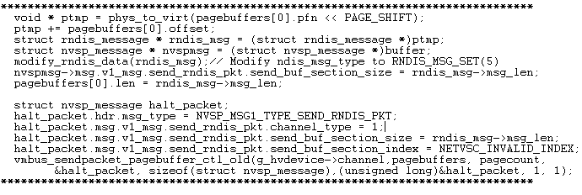
CVE-2019-0720
This important thread should running before Thread1&Thread2, so we should use the following codes in PoC to set function vmswitch!VmsVmNicPvtRevokeRecieveBufferWorkItem into a sleep state.
Notes:
But this important thread should running before Thread1 and Thread2, so we should use the following codes in PoC to set function vmswitch!VmsVmNicPvtRevokeRecieveBufferWorkItem into a sleep state. The following is the implementation in PoC.

Slide 75
CVE-2019-0720
The principle of above code in PoC
Set function vmswitch!VmsVmNicPvtRevokeRecieveBufferWorkItem's second parameter offset 0xe0 's memory to a non-zero value, and this function will into a sleep state until offset 0xe0 's memory set to zero.
Fortunately☺, we can also use "efi.reset_system(0, EFI_SUCCESS, 0, NULL);" to set zero in offset 0xe0 's memory indirectly.
Notes:
The principle of above code in PoC is

Slide 76
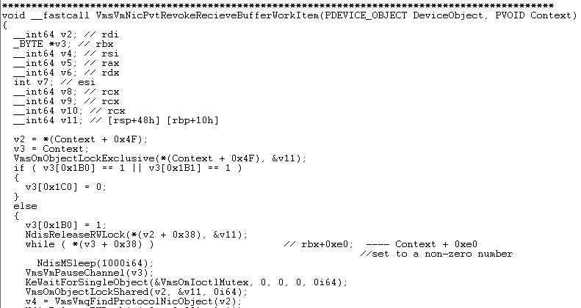
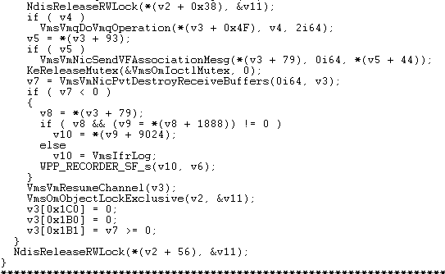
CVE-2019-0720
The principle of above code in PoC
Set function vmswitch!VmsVmNicPvtRevokeRecieveBufferWorkItem's second parameter offset 0xe0 's memory to a non-zero value, and this function will into a sleep state until offset 0xe0 's memory set to zero.
Fortunately☺, we can also use "efi.reset_system(0, EFI_SUCCESS, 0, NULL);" to set zero in offset 0xe0 's memory indirectly.
Notes:
The principle of above code in PoC is set function vmswitch!VmsVmNicPvtRevokeRecieveBufferWorkItem's second parameter offset 0xe0 's memory to a not zero value, and this function will into a sleep state until offset 0xe0 's memory set to zero. Fortunately, we can also use EFI reset_system to set zero in offset 0xe0 's memory indirectly.

Slide 77
CVE-2019-0720
The principle of above code in PoC
Set function vmswitch!VmsVmNicPvtRevokeRecieveBufferWorkItem's second parameter offset 0xe0 's memory to a non-zero value, and this function will into a sleep state until offset 0xe0 's memory set to zero.
Fortunately☺, we can also use "efi.reset_system(0, EFI_SUCCESS, 0, NULL);" to set zero in offset 0xe0 's memory indirectly.
We create two non-interfering
Threads running to function
vmbusr!ChUnmapGpadlView
at the same time indirectly!!!
Notes:
Now, we can create two non-interfering threads running to function vmbusr!ChUnmapGpadlView at the same time indirectly!

Slide 78
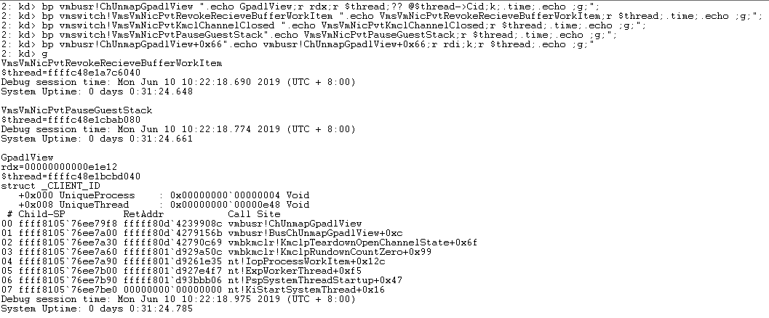
CVE-2019-0720 debugging & trigger
Notes:
Now, let’s trigger and debugging this vulnerability.
In the picture, breakpoint zero is used for print stack backtrace, print the value of gpadl_handle and which thread calls this function. Breakpoint one two three is used for which thread call them. Breakpoint four is used for watch the return value of RtlLookupElementGenericTableAvl , and which thread calls ChUnmapGpadlView. Now, run PoC and trigger this issue.

Slide 79
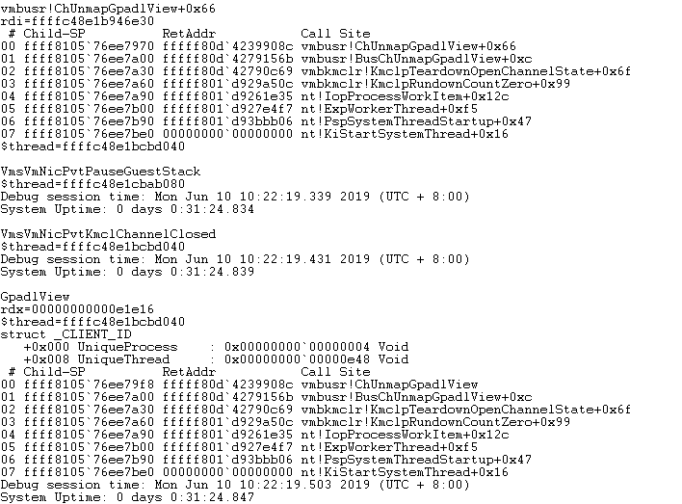
CVE-2019-0720 debugging & trigger
Notes:
In the debugging log, you can see the PoC trigger the important thread, the VMsVmNicPvtPauseGuestStack.

Slide 80

CVE-2019-0720 debugging & trigger
Notes:
And then, at the red mark, you can see a Thread2 Stack Backtrace. The value of gpadl_handle is 0xe1e14.

Slide 81

CVE-2019-0720 debugging & trigger
Notes:
The following debugging log, it is a Thread1 Stack Backtrace, the value of gpadl_handle is 0xe1e14 too. Then, the breakpoint four was triggered twice, the return values of RtlLookupElementGenericTableAvl are same.

Slide 82

CVE-2019-0720 debugging & trigger
Notes:
And BOOM!

Slide 83

CVE-2019-0720 debugging & trigger
UAF!
Notes:
As you can see, the kernel pool was already freed. It is a typical UAF issue.

Slide 84
CVE-2019-0720
Race condition : Because of VM shutdown, Host will auto recycle the VM resource. But we can also use some VM resource and do something. In this case, send a NVSP_MSG1_TYPE_REVOKE_RECV_BUF message when VM reset(efi.reset_system(0, EFI_SUCCESS, 0, NULL);).
In a word : Use Resource When Auto Recycle
Notes:
The root cause of this vulnerability is race condition, because of VM shutdown, Host will auto recycle the VM resource. But we can also use some VM resource and do something. For example, in this case, send a NVSP_MSG1_TYPE_REVOKE_RECV_BUF message when VM reset. In a word: Use resource when auto recycle. I think it is a tip for bug hunting.

Slide 85
CVE-2019-0720
Exploit thinking
Find suitable object for kernel pool Spray.
But the time window between two threads is very short, kernel pool Spray is not easy to succeed.
Use interrupt to interfere with one of the threads, then cause thread switching, increase the time window.
Why failed?
The thread lock is a Spin Lock☹.
Notes:
About exploit thinking, I think I should find suitable object for kernel pool spray. But I found the time window between two threads is very short, kernel pool Spray is not easy to succeed. Then I thought maybe I can use interrupt to interfere with one of the threads, then cause thread switching, increase the time window. But the thread lock is a spin lock, I can’t use interrupt to interfere with one of the threads and cause thread switching.

Slide 86

CVE-2020-16891
Notes:
The last RCE vulnerability is cve-2020-16891, this picture is the scene of the crash.

Slide 87

CVE-2020-16891
Notes:
It is an UAF issue in Hyper-V Root Partition’s vmwp.exe process.

Slide 88
CVE-2020-16891
This vulnerability requires Windows Server category OS.
Set "Network Adapter"—>"Hardware Acceleration"—>"Enable SR-IOV" in the virtual machine settings.
In the "Virtual Switch Manager", virtual network adapter should enable "Enable single-root I/O virtualization" and select a network adapter that must support SR-IOV at the hardware level.
For example, I select "Intel(R) Ethernet 10G 4P X540/I350 rNDC #2".
Notes:
This vulnerability requires Windows Server category OS and needs some settings.

Slide 89

CVE-2020-16891
This vulnerability require Windows Server category OS.
Set "Network Adapter"—>"Hardware Acceleration"—>"Enable SR-IOV" in the virtual machine settings.
In the "Virtual Switch Manager", virtual network adapter should enable "Enable single-root I/O virtualzation" and select a network adapter that must support SR-IOV at the hardware level.
For example, I select "Intel(R) Ethernet 10G 4P X540/I350 rNDC #2".
Notes:
In "Virtual Switch Manager", select a network adapter that must support SR-IOV at the hardware level. For example, I select Intel X540 ethernet adapter.
In the VM settings, set “Network Adapter”—>”Hardware Acceleration“—>”Enable SR-IOV“. In the "Virtual Switch Manager", virtual network adapter should enable "Enable single-root I/O virtualization" and select a network adapter that must support SR-IOV at the hardware level. For example, I select Intel X540 ethernet adapter.

Slide 90
CVE-2020-16891
The issue exists in function vmwp!EmulatorVp::FlushGvaTranslationCache
Notes:
The issue exists in function Emulator Vp::FlushGvaTranslationCache. Let’s see what it looks like.

Slide 91

CVE-2020-16891
The issue exists in function vmwp!EmulatorVp::FlushGvaTranslationCache
Notes:
This is the disassembly code of this function.

Slide 92

CVE-2020-16891
The issue exists in function vmwp!EmulatorVp::FlushGvaTranslationCache
Notes:
At the red mark, FlushGvaTranslationCache invoke vhd handler context remove reference.

Slide 93
CVE-2020-16891
vmwp!EmulatorVp::FlushGvaTranslationCache+0x9e → vmwp!VND_HANDLER_CONTEXT::RemoveReference→ vmwp!Vml::VmSharableObject::DecrementUserCount
If vmwp!VND_HANDLER_CONTEXT::RemoveReference first parameter offset-0x50’s value is 1, vmwp!Vml::VmSharableObject::DecrementUserCount will free a VmbComMmioHandlerAdapter object of size 0xb0.
PS : The first parameter offset-0x50 is a reference counter’s address, if the reference counter equal to 1, a VmbComMmioHandlerAdapter object will be recycled, and free a 0xb0 size heap chunk. In the following presentation, the reference counter will be referred to as KEY_REF_COUNTER.
Notes:
And the function vhd handler context remove reference invoke Vml VmSharableObject DecrementUserCount to free a VmbComMmioHandlerAdapter object if the function vhd handler context removes reference first parameter offset minus 0x50’s value is one. Actually, the first parameter offset minus 0x50 is a reference counter’s address. In the following presentation, the reference counter will be referred to as KEY_REF_COUNTER

Slide 94
CVE-2020-16891
vmwp!VndCompletionHandler::HandleVndCallback can also invoke Vml::VmSharableObject::DecrementUserCount
vmwp!VndCompletionHandler::HandleVndCallback invoke Vml::VmSharableObject::DecrementUserCount to decrease an object’s reference count.
The KEY_REF_COUNTER can also be modified by function Vml::VmSharableObject::DecrementUserCount at address vmwp!VndCompletionHandler::HandleVndCallback+0xAAE.
Notes:
VndCompletionHandler HandleVndCallback can also invoke Vml VmSharableObject DecrementUserCount to decrease an object’s reference count. The KEY_REF_COUNTER can be modified by this function.

Slide 95


CVE-2020-16891
The PoC code is control vmwp.exe process runs to address vmwp!VndCompletionHandler::HandleVndCallback+0xAAE
Notes:
The PoC code is control vmwp process runs to address VndCompletionHandler HandleVndCallback offset 0xAAE. The principle of the code is send PCI BUS D zero ENTRY message and PCI BUS D zero EXIT message.

Slide 96

CVE-2020-16891
The PoC code is control vmwp.exe process runs to address vmwp!EmulatorVp::FlushGvaTranslationCache+0x9e
What is virt_addr+0x1004 ?
Notes:
The PoC code is control vmwp process runs to address EmulatorVp FlushGvaTranslationCache offset 0x9e. This code writes two and zero to an IO address. But what is it?

Slide 97

CVE-2020-16891
The PoC code is control vmwp.exe process runs to address vmwp!EmulatorVp::FlushGvaTranslationCache+0x9e
What is virt_addr+0x1004 ?
Notes:
By referencing to the Linux source tree, I found this offset is the PCI_COMMAND’s IO address, and writes two and zero to an IO address maybe means enable and disable response in memory space.

Slide 98

CVE-2020-16891 debugging & trigger
Notes:
Now, let’s trigger this bug and debugging.
The breakpoint one is easier to observe changes in key ref counter, the breakpoint two is used for watch changes in key ref counter influenced by function VndCompletionHandler HandleVndCallback.

Slide 99

CVE-2020-16891 debugging & trigger
KEY_REF_COUNTER
Notes:
For example, the key ref counter like this.

Slide 100

KEY_REF_COUNTER was decremented by 1 here.
CVE-2020-16891 debugging & trigger
KEY_REF_COUNTER
KEY_REF_COUNTER
Notes:
Omit some debug content, and we come to the place where the issue happened. In the picture, the key ref counter was decremented by 1 at VndCompletionHandler HandleVndCallback offset 0xaae. In the following debug logging, the key ref counter’s value is 1, a VmbComMmioHandlerAdapter object will be recycle.

Slide 101

KEY_REF_COUNTER was decremented by 1 here.
VmbComMmioHandlerAdapter object
CVE-2020-16891 debugging & trigger
KEY_REF_COUNTER
KEY_REF_COUNTER
KEY_REF_COUNTER
Notes:
Now, the object has not been freed yet. Let’s single step tracking and debugging. The vmwp process runs to Flush GVA Translation Cache and invoke VHD HANDLER CONTEXT remove reference.

Slide 102

KEY_REF_COUNTER was decremented by 1 here.
VmbComMmioHandlerAdapter object
CVE-2020-16891 debugging & trigger
Free VmbComMmioHandlerAdapter object here
KEY_REF_COUNTER
KEY_REF_COUNTER
KEY_REF_COUNTER
Notes:
Enable the breakpoint three, and you can see the stack backtrace of recycle the VmbComMmioHandlerAdapter object.

Slide 103

KEY_REF_COUNTER was decremented by 1 here.
VmbComMmioHandlerAdapter object
CVE-2020-16891 debugging & trigger
Free VmbComMmioHandlerAdapter object here
Use freed memory
KEY_REF_COUNTER
KEY_REF_COUNTER
KEY_REF_COUNTER
Notes:
Let’s enable breakpoint zero and continue running the process. In the picture, emulator VP Actually Attempt Emulation offset 0x290 uses an already freed heap memory. The RCX register’s value is the VmbComMmioHandlerAdapter object address.

Slide 104

KEY_REF_COUNTER was decremented by 1 here.
VmbComMmioHandlerAdapter object
CVE-2020-16891 debugging & trigger
Free VmbComMmioHandlerAdapter object here
Use freed memory
KEY_REF_COUNTER
KEY_REF_COUNTER
KEY_REF_COUNTER
Notes:
If we can control contents of the object that has been freed here, maybe we can control the RIP register.

Slide 105
CVE-2020-16891
Exploit thinking
Find suitable object for heap Spray in a vmwp.exe process.
Why failed?
Still finding…
Notes:
So, I thought I should find a suitable object for heap spray in VMWP process. But I’m still looking for…

Slide 106
Attack Interface
#BHUSA @BlackHatEvents
Notes:
About attack interface

Slide 107
Attack Interface
VMWP.exe (Ring3)
vmiccore.dll
vmicvdev.dll
vmuidevices.dll
vmdynmem.dll
vmconnect.exe
socket
Host Kernel Space(Ring 0)
Network
vmswitch.sys
vmsproxy.sys
vmsproxyhnic.sys
Storage
storvsp.sys
vhdparser.sys
vhdmp.sys
I/O write & read
R/W VMBUS
Ringbuffer
R/W VMBUS
Ringbuffer
VMBUS
vmbusr.sys
vmbkmclr.sys
winhvr.sys
hvsocket
hvsocket.sys
hvsocketcontrol.sys
PCI
vpcivsp.sys
R/W VMBUS Ringbuffer
R/W VMBUS
Ringbuffer
vmcall
Interrupt injection
Hypervisor Ring -1 (hvix64.exe/hvax64.exe)
Notes:
The figure is an overview of the Hyper-V attack interface, where the red markers represent the component where the vulnerabilities have been disclosed so far.

Slide 108
Attack Interface
vmcall
MSRs W/R
APIC Address operation
Nested Virtual Machine
Guest Ring0
Interrupt
vmcall
vmcall
MSRs virtualization
APIC virtualization
Nested virtualization
Guest Physical Address Translate
Hypervisor Ring-1
Notes:
Hypervisor attack interfaces can be reached by executing VMCALL instruction, reading and writing MSR registers, operating APIC address, and running nested virtual machine.

Slide 109
Attack Interface
VMCALL 0x5C HVCALL_POST_MESSAGE (vmbus_post_msg)
CHANNELMSG_*
For example : CHANNELMSG_OPENCHANNEL
CHANNELMSG_CLOSECHANNEL
etc…
Guest Ring0
Interrupt
vmcall
Hypervisor Ring-1
vmcall
Interrupt
Process channel Message From Guest
ChReceiveChannelMessage
Host VMBUS
ChmOpenChannel
ChmCloseChannel
etc…
Notes:
VMBUS attack interfaces can be reached by sending channel messages.
For example, send a channel message open channel message will trigger chm open channel function on the host side.

Slide 110
Attack Interface
VMCALL 0x5D HVCALL_SIGNAL_EVENT
hv_netvsc.ko
hv_storvsc.ko
pci-hyperv.ko
hv_sock.ko
Guest Ring0
vmbus_sendpacket
Interrupt
vmcall
Hypervisor Ring-1
vmcall
Interrupt
Network :
VmsVmNicPvtKmclProcessPacket, VmsVmNicPvtKmclProcessingComplete
Storage :
VspPvtKmclProcessPacket, VspPvtKmclProcessingComplete
PCI :
VirtualBusChannelProcessPacket
Hvsocket :
VmbusTlXPartIndicateReceive
Host VMBUS
Host Driver
Notes:
Host drivers attack interfaces can be reached by calling vmbus_sendpacket function to send Guest Data to a specified virtual device.
The following functions are used for process data sent by the guest.

Slide 111
Attack Interface
VMCALL 0x5D HVCALL_SIGNAL_EVENT
hv_utils.ko
hid_hyperv.ko, hyperv_keyboard.ko, hyperv_fb.ko
hv_balloon.ko
Remote Desktop Virtualization device
Guest Ring0
vmbus_sendpacket
Interrupt
vmcall
Hypervisor Ring-1
vmcall
Interrupt
Integration Services :
vmicvdev.dll vmiccore.dll
Keyboard, Mouse, Synthetic Video :
vmuidevices.dll
Dynamic memory :
vmdynmem.dll
Remote Desktop Virtualization :
vmconnect.exe
Host VMBUS
I/O read & write
VMWP.exe
&
Vmconnect.exe
Notes:
The figure shows the relationships between the driver files in the virtual machine and the ring three components in the host machine.

Slide 112
Concluding Thoughts
#BHUSA @BlackHatEvents
Notes:
Concluding thoughts

Slide 113
Concluding Thoughts
Hyper-V still has low-hanging apples.
It makes more sense to find a way to exploit Hyper-V.
It makes sense to pay attention to Hyper-V updates. New features/new updates of some components may make it easier to find vulnerabilities. It is a easy way of Bug Hunting☺.
Notes:
There are some of my thoughts on Hyper-V security research, I think Hyper-V still has low-hanging apples, because some new vulnerabilities trigger logic is very shallow. And it makes more sense to find a way to exploit Hyper-V, an exploit is far more valuable than PoC. It makes sense to pay attention to Hyper-V updates. New features new updates of some components may make it easier to find vulnerabilities. It is an easy way of Bug Hunting.

Slide 114


Concluding Thoughts
Potential Attack Interface
Packet Direct functions in vmswitch.sys
Network Direct device
PCI Pass-Through
Hypervisor nested virtualization
Notes:
There are some thoughts on potential attack interface. The packet direct functions in VMSWITCH and network direct device are not enabled in default configuration, which may become a potential attack interface. PCI pass-through and nested virtualization are also good research orientations because these functions are not commonly used.

Slide 115
Thank you for listening!
Twitter : @rthhh17
#BHUSA @BlackHatEvents
Notes:
Thank you for listening!

